Slide 1
Endocrine Disorders and Cardiovascular Disease
DR VIVEK C WARRIER
SENIOR RESIDENT
DEPARTMENT OF CARDIOLOGY, GMC CALICUT

Slide 2
The endocrine system is linked closely with many important cardiovascular diseases.
Hormones can alter the cardiovascular system through changes in lipid metabolism & actions on cardiac myocytes, vascular smooth muscle cells, & other target cells & tissues.

Slide 3
PITUITARY HORMONES
ADRENAL HORMONES
THYROID HORMONES
PARATHYROID HORMONES

Slide 4
Pituitary Hormones and Cardiovascular Disease
The anterior pituitary, or adenohypophysis, contains six different cell types; five of them produce polypeptide or glycoprotein hormones, & one, the sixth, consists of nonsecretory chromophobic cells.
Of these cell types, the somatotropic cells, which
secrete human growth hormone (hGH), & the corticotropic
cells, which produce adrenocorticotropic
hormone (ACTH), can contribute to cardiac disease.

Slide 5
Growth Hormone
Excessive secretion of hGH & insulin-like growth factor type 1 (IGF-1) by benign pituitary adenomas leads to the clinical syndrome of gigantism in youth, & to acromegaly in adults.
hGH exerts its cellular effects through two major pathways :
Firstly, by binding of the hormone to specific hGH receptors on target cells. Such receptors exist in the heart, skeletal muscle, fat, liver, & kidneys, as well as in many additional cell types throughout fetal development.
Secondly - stimulation of the synthesis of IGF-1. The liver produces most of the IGF-1, but other cell types can produce IGF-1 under the influence of hGH.

Slide 6
Cardiovascular Manifestations of Acromegaly
About 60% of acromegalic patients develop cardiovascular disease.
Hypertension, insulin resistance, diabetes mellitus, & hyperlipidemia are the cardiovascular risk factors associated most frequently with acromegaly.
Death in acromegalic patients occurs primarily from cardiovascular disease & diabetes, especially in undiagnosed & untreated patients.
The recently published Endocrine Society Clinical Practice Guidelines recommend that acromegalic patients undergo evaluation for associated comorbidities (hypertension, diabetes mellitus, cardiovascular disease, & sleep apnea).

Slide 7
The cardiovascular & hemodynamic effects of acromegaly vary considerably depending on the patient's age & the disease's severity & duration.
A specific acromegalic cardiomyopathy develops in patients with persistently increased secretion of hGH & IGF-1.
It is manifested as biventricular concentric hypertrophy.
Two thirds of patients with acromegaly meet echocardiographic criteria for left ventricular hypertrophy (LVH); the right ventricular mass also increases in acromegaly, a finding indicating a more generalized process than systemic hypertension.

Slide 8
This specific cardiomyopathy has three phases.
The first phase typically develops in young patients with new-onset acromegaly & involves a hyperkinetic syndrome with increased myocardial contractility & enhanced cardiac output.
The second phase of cardiomyopathy has more evident hypertrophy & is associated with impaired diastolic filling, which reduces the cardiac performance during exercise.
Third phase- Impaired systolic function & low cardiac output progressively develop in the late phase of the disease in patients in whom acromegaly is undiagnosed or undertreated. Heart failure can complicate this late phase of the disease

Slide 9
The clinical disease activity of patients with an excess of hGH is correlated better with serum levels of IGF-1 than with hGH concentrations.
Secondary hypertension accompanies acromegaly & occurs with a mean prevalence of 33% to 46%.
The mechanism underlying hypertension in acromegaly remains poorly understood.
Administration of hGH promotes sodium retention & volume expansion, & IGF-1 has a potent antinatriuretic effect independent of any effect on aldosterone.

Slide 10
Studies of the renin-angiotensin aldosterone system have shown failure to inhibit release of renin optimally by volume expansion.
Impaired glucose tolerance & diabetes mellitus occur in 15% to 38% of acromegalic patients.
Acromegaly increases the prevalence of aortic & mitral valve disease, which persists despite cure of the acromegaly.
Patients with acromegaly may exhibit dilation of the aortic root.
Abnormalities on the electrocardiogram (ECG), including left axis deviation, septal Q waves, ST-T wave depression, abnormal QT dispersion, & conduction system defects, develop in up to 50% of patients with acromegaly.

Slide 11
Diagnosis
In 99% of cases, acromegaly arises from benign adenomas of the anterior pituitary gland.
At diagnosis most of these neoplasms are classified as macroadenomas (> 10 mm).
The biochemical diagnosis of acromegaly depends on demonstrating elevated serum IGF-1 levels & the lack of suppression of hGH to less than 1 μg/L following an oral glucose load.
Localization of the tumor uses magnetic resonance imaging (MRI) of the pituitary gland.

Slide 12
Treatment
Transsphenoidal surgery with resection of the adenoma cures 50% to 70% of patients.
Preoperative medical therapy with somatostatin receptor agonist is recommended to reduce the surgical risk in patients with heart failure or severe comorbidities.
The cardiovascular complications of acromegaly usually improve with treatment, & survival rates improve significantly in patients achieving disease remission as defined by the normalization of serum IGF-1 & serum hGH levels to less than 1 μg/L.
A residual tumor mass following surgery may require radiotherapy if medical therapy is unavailable, unsuccessful, or not tolerated.

Slide 13
Cardiovascular Manifestations of Growth Hormone Deficiency
Untreated adult hGH-deficient patients can have cardiac & endothelial dysfunction, insulin resistance, a deranged lipid profile, increased carotid intima-media thickness, elevated inflammatory markers, increased body fat with abdominal obesity, hypercoagulability, & decreased skeletal muscle mass & strength.
Early premature atherosclerosis can develop in hypopituitary patients not receiving hGH therapy.

Slide 14
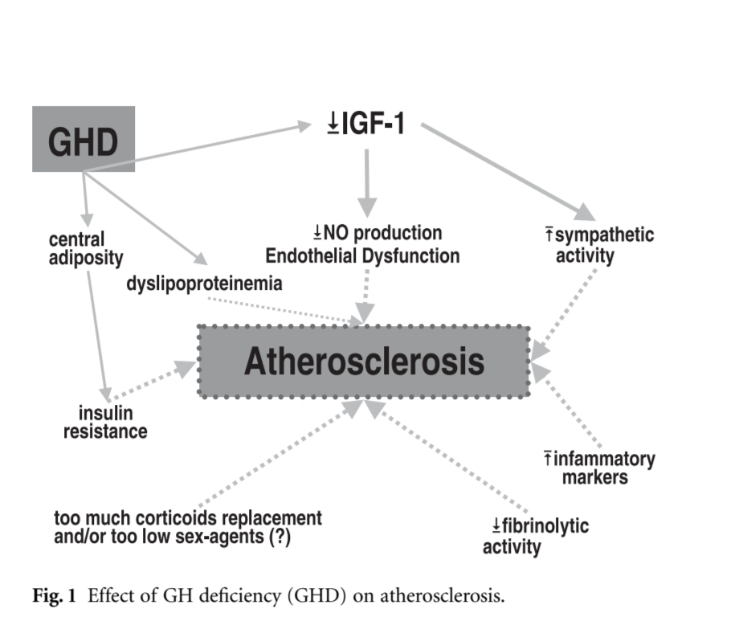

Slide 15
Adrenal Hormones and Cardiovascular Disease
Cushing Disease & Cushing Syndrome
Cushing syndrome results from prolonged & inappropriately high exposure of tissues to glucocorticoids.
Excessive cortisol secretion & its attendant clinical disease states can arise from excessive release of ACTH by the pituitary (Cushing disease) or through the adenomatous or rarely malignant neoplastic process arising in the adrenal gland itself (Cushing syndrome).

Slide 16
Clinical signs & symptoms of Cushing syndrome often develop in patients treated with exogenous steroids at doses equivalent to 20 mg of prednisone daily for more than 1 month.
Several cardiac genes contain glucocorticoid response elements in their promoter regions that confer transcriptional-level glucocorticoid responsiveness.
Include those that encode voltage-gated potassium channels, as well as protein kinases, which serve to phosphorylate & regulate the voltage-gated sodium channels.
In addition, there are more rapidly acting, nontranscriptional pathways by which cortisol may regulate the activity of voltage-gated potassium channels.

Slide 17
The cardiac effects of Cushing syndrome arise from the effects of glucocorticoids on the heart, liver, skeletal muscle, & fat tissue.
LVH & concentric remodeling can result.
Glucocorticoid excess is also associated with left ventricular dysfunction, myocardial fibrosis, & dilated cardiomyopathy.
Chronic cortisol hypersecretion causes central obesity, hypertension, insulin resistance, dyslipidemia, a prothrombotic state, & the metabolic syndrome.

Slide 18
Electrocardiographic changes of Cushing disease :
The duration of the PR interval appears to be correlated inversely with adrenal cortisol production rates.
The mechanism underlying this correlation may be related to expression or regulation of the voltage-gated sodium channel (SCN5A).
Changes on the ECG, specifically in the PR & QT intervals, may also arise from the direct (nongenomic) effects of glucocorticoids on the voltage-gated potassium channel (Kv1.5) in excitable tissues.

Slide 19
A particular complex of cardiac & adrenal lesions, referred to as the Carney complex, is a combination of Cushing syndrome, cardiac myxoma, & a variety of pigmented dermal lesions.
This monogenic autosomal dominant trait has been mapped to the q2 region of chromosome 17.
Myxomas most commonly occur in the left atrium but can arise throughout the heart, can develop at young ages, & can be multicentric.

Slide 20
Diagnosis
The diagnosis of Cushing disease & Cushing syndrome requires the demonstration of increased cortisol production as reflected by an elevated 24-hour urinary free cortisol level or nocturnal salivary cortisol level.

Slide 21
Treatment
Initial resection of primary lesion(s) is recommended for underlying Cushing disease (based in the pituitary) & also for Cushing disease related to ectopic & adrenal causes.
Transsphenoidal selective resection with or without postoperative radiation therapy can partially or completely reverse the increased ACTH.
Cushing syndrome requires surgical removal of one adrenal gland (adrenal adenoma, adrenal carcinoma) or both adrenal glands (multiple nodular disease).

Slide 22
Immediately after surgery, cortisol & mineralocorticoid (fludrocortisone) need to be replaced to prevent adrenal insufficiency.
Drug therapy before or after surgery can help control persistent cortisol production.
Pasireotide (somatostatin analogue ) can decrease ACTH production from a pituitary tumor.
The adrenal enzyme inhibitor ketoconazole may be used alone or in combination with metyrapone to enhance control of severe hypercortisolemia.

Slide 23
Mitotane is used primarily to treat adrenal carcinoma.
Mifepristone blocks the direct effect of cortisol on tissues & leads to an improvement in hypertension &/or diabetes in 40% to 60% of patients.

Slide 24
Primary Hyperaldosteronism
Aldosterone production by the zona glomerulosa is responsive to the renin-angiotensin system.
Renin secretion responds primarily to changes in intravascular volume.
Aldosterone synthesis & secretion depend primarily on regulation by angiotensin II, which binds to the angiotensin II type I receptor on cells of the zona glomerulosa.

Slide 25
Common causes of PA include an adrenal adenoma, unilateral or bilateral adrenal hyperplasia, or, in rare cases, an adrenal carcinoma or an inherited condition known as glucocorticoid-remediable aldosteronism.
Aldosterone enters cells & binds to the mineralocorticoid receptor, which then is translocated to the nucleus & promotes the expression of aldosterone-responsive genes.
Primary aldosteronism can induce development of cardiac hypertrophy, myocardial fibrosis, & diastolic dysfunction.
More than 10% of hypertensive patients have primary aldosteronism, & normokalemic hypertension constitutes the most common presentation of the disease.

Slide 26
Primary aldosteronism is associated with higher rates of cardiovascular morbidity & mortality than age- & sex-matched patients with essential hypertension.
Primary aldosteronism should be investigated in patients with
(1) severe hypertension,
(2) treatment-resistant hypertension,
(3) hypertension with spontaneous or diuretic-
induced hypokalemia,
(4) hypertension with adrenal incidentaloma,
(5) hypertension & sleep apnea, or
(6) a family history of early-onset hypertension or
cerebrovascular accident at a young age
(< 40 years of age).

Slide 27
The plasma aldosterone/renin ratio detects possible PA.( ratio >20 , PAC > 15ng/dl)
Mineralocorticoid receptor antagonists should be withdrawn for at least 4 weeks before testing.
Patients with an abnormal aldosterone/renin ratio undergo one or more confirmatory tests to definitively confirm or exclude the diagnosis.
After sodium loading, plasma aldosterone levels lower than 5 ng/dL make the diagnosis of PA unlikely.
Levels above 10 ng/dL indicate very probable PA.
Patients with spontaneous hypokalemia, plasma renin levels below detection levels, & plasma aldosterone concentrations of more than 20 ng/dL do not require further testing.

Slide 28
Treatment
Patients with primary hyperaldosteronism & hypokalemia should receive slow-release potassium chloride supplementation to maintain plasma potassium.
The aldosterone antagonist spironolactone or eplerenone (as a second choice) should be used to control hypertension, hypokalemia, & the deleterious cardiovascular effects of aldosterone hypersecretion.

Slide 29
Unilateral laparoscopic adrenalectomy can cure hypokalemia & improve or cure hypertension in patients with unilateral disease
Patients with bilateral disease & those reluctant to undergo surgery should receive medical treatment with mineralocorticoid receptor antagonists.
Genetic testing for familial hyperaldosteronism should be performed in patients with a family history of hypertension & stroke at a young age (< 40 years).

Slide 30
Addison Disease
Primary adrenal insufficiency occurs when the adrenal cortex cannot produce sufficient glucocorticoids &/or mineralocorticoids.
Acute Addisonian crisis, one of the most severe endocrine emergencies, is characterized by hypovolemia, hypotension, & acute cardiovascular collapse resulting from renal sodium wasting, hyperkalemia, & loss of vascular tone.
Primary adrenal insufficiency arises most commonly from bilateral loss of adrenal function on an autoimmune basis; as a result of infection, hemorrhage, or metastatic malignancy.

Slide 31
Addison disease may be associated with other autoimmune disorders (e.g., Hashimoto thyroiditis, type 1 diabetes mellitus, autoimmune gastritis/pernicious anemia, & vitiligo).
Secondary adrenal insufficiency, which results from pituitary-dependent loss of ACTH secretion, leads to a fall in glucocorticoid production; mineralocorticoid production remains at relatively normal levels.
The noncardiac symptoms, including increased pigmentation, abdominal pain with nausea & vomiting, hypoglycemia, & weight loss, can be chronic; tachycardia, hypotension, hyponatremia, hyperkalemia, loss of autonomic tone, & cardiovascular collapse & crisis may develop, especially in acutely ill or untreated patients with Addison disease.

Slide 32
Blood pressure measurements uniformly show a low diastolic pressure (< 60 mm Hg) along with orthostatic changes that reflect loss of volume & acquired autonomic dysfunction.
Laboratory findings (hyponatremia & hyperkalemia) indicate loss of aldosterone production (renin levels are high).
Cardiac atrophy is an unusual condition; it is seen with malnutrition caused by anorexia, in astronauts after prolonged space flight, in populations with sodium-deficient diets, & characteristically with Addison disease (teardrop heart).
This atrophy reflects a response to decreases in the cardiac workload because restoration of normal plasma volume with mineralocorticoid & glucocorticoid replacement increases ventricular mass.

Slide 33
Diagnosis
Acute adrenal insufficiency characteristically occurs in the setting of acute stress, infection, or trauma in a patient with chronic autoimmune adrenal insufficiency.
Acute adrenal insufficiency can develop in patients treated over a long term with suppressive doses of corticosteroids (> 10 mg of prednisone for > 1 month) if treatment is stopped precipitously or if an acute, severe, non–endocrine-related illness arises.
The diagnostic criteria include low cortisol levels (morning cortisol < 140 nmol/L [< 5 μg/dL]) or cortisol levels that fail to rise above 500 nmol/L (20 μg/dL) 30 or 60 minutes after an intravenous injection of 250 μg of corticotropin.

Slide 34
Treatment
Management of acute addisonian crisis requires adequate hydrocortisone replacement therapy (100 mg given as an initial intravenous bolus; then 100 mg every 8 to 12 hours for the first 24 hours, & tapering of the dose over the next 72 to 96 hours).
Large volumes of normal saline can address the intravascular fluid deficit.
Potential underlying precipitating causes (including infection, acute cardiac or cerebral ischemia, or intraabdominal emergency) require identification & treatment.

Slide 35
Long-term treatment of adrenal insufficiency consists of oral corticosteroid therapy (hydrocortisone ≈20 mg in two divided oral doses per day, or prednisone 5 mg administered orally once or twice daily).
Patients with confirmed aldosterone deficiency should receive mineralocorticoid replacement with fluorohydrocortisone (starting dose, 50 to 100 μg in adults).

Slide 36
Pheochromocytoma
Pheochromocytomas are primarily benign tumors arising from neuroectodermal chromaffin cells; they usually arise in the adrenal medulla & abdomen, but they may arise anywhere in the plexus of sympathetic adrenergic nerves.
About 20% are familial.
Six different familial autosomal dominant diseases can be suspected clinically: neurofibromatosis type 1, multiple endocrine neoplasia type 2 (MEN2), von Hippel-Lindau syndrome, renal cell carcinoma with SDHB mutation, Carney triad (paragangliomas, gastric stromal tumors, pulmonary chondromas), & Carney-Stratakis syndrome (paragangliomas & gastric stromal sarcomas).

Slide 37
Clinical manifestations of pheochromocytoma include headache, palpitations, excessive sweating, tremulousness, chest pain, weight loss, & a variety of other constitutional complaints.
Hypertension may be episodic but is usually constant & is paradoxically associated with orthostatic hypotension on arising in the morning.
The paroxysmal attacks & classic symptoms result from episodic excessive catecholamine secretion.
Hypertension caused by pheochromocytoma can first present at the time of elective surgical intervention for an unrelated condition.

Slide 38
As a result of release of norepinephrine with an increase in systemic vascular resistance, cardiac output is minimally increased despite increases in the heart rate.
The ECG can show LVH, repolarization abnormalities, findings suggesting left ventricular strain.
Impaired left ventricular function & cardiomyopathy have occurred in patients with pheochromocytoma.
mechanisms include
an increased left ventricular work & LVH from associated hypertension;
potential adverse effects of excess catecholamines on myocyte structure & contractility;
& changes in coronary arteries, including thickening of the media, which presumably impairs blood flow to the myocardium.

Slide 39
Reversible dilated hypertrophic cardiomyopathy & takotsubo cardiomyopathy are well-established cardiac manifestations of pheochromocytoma.
The primary catecholamine released from adrenal pheochromocytomas is norepinephrine.
Demonstration of elevated serum dopamine levels implies malignant transformation, which in turn suggests that the tumor may have arisen in an extraadrenal site.
Rarely, pheochromocytoma can arise within the heart, presumably from chromaffin cells, which are part of the adrenergic autonomic paraganglia.

Slide 40
Diagnosis
Quantitative 24-hour urinary fractionated metanephrine levels are the most reliable screening procedures; they provide a sensitivity of 97% & a specificity of 91%.
CT is the first-choice imaging modality because of its excellent spatial resolution for the thorax, abdomen, & pelvis.
MRI is recommended in patients with metastatic disease & for detection of skull base & neck paragangliomas.

Slide 41
Treatment
Definitive treatment of pheochromocytoma requires removal of the lesion.
Accurate preoperative localization reduces the operative mortality rate & eliminates the need for exploratory laparotomy.
Endoscopic procedures are now standard for small tumors, & open resection is indicated for large tumors (e.g., > 6 cm) or invasive pheochromocytomas.
Preoperative pharmacologic treatment includes 7 to 14 days of alpha-adrenergic blockade (usually with doxazosin, prazosin, or phenoxybenzamine) to normalize the blood pressure.

Slide 42
Beta-blocking drugs can normalize the heart rate but should follow the establishment of a sufficient alpha blockade.
Before surgical treatment, a high sodium diet & fluid intake should be started to improve the blood volume contraction & prevent severe hypotension after tumor removal.
Lifelong annual biochemical testing to assess for recurrent or metastatic disease is necessary.

Slide 43
Parathyroid Hormones and Cardiovascular Disease
Diseases of the parathyroid glands can produce cardiovascular disease & alter cardiac function through two mechanisms.
Parathyroid hormone (PTH) is a protein hormone that can affect the heart, vascular smooth muscle cells, & endothelial cells.
PTH-induced changes in serum calcium levels also affect the cardiovascular system.

Slide 44
PTH can bind to its receptor and alter the spontaneous beating rate of neonatal cardiac myocytes through an increase in intracellular cyclic adenosine monophosphate (cAMP).
PTH can also alter the calcium influx & cardiac contractility in adult cardiac myocytes & the relaxation of vascular smooth muscle cells.

Slide 45
Hyperparathyroidism
Primary hyperparathyroidism producing hypercalcemia most often results from adenomatous enlargement of one of the four parathyroid glands.
Cardiovascular actions of hypercalcemia include increased cardiac contractility; shortening of the ventricular action potential duration, primarily through changes in phase 2; & blunting of the T wave & changes in the ST segment, occasionally suggesting cardiac ischemia.
The QT interval shortens & occasionally the PR interval decreases.

Slide 46
Hypercalcemia may lead to pathologic changes in the heart, including the myocardial interstitium & conducting system, as well as calcific deposits in the valve cusps, annuli, & possibly coronary arteries.
Metastatic calcifications can also occur in secondary parathyroid disease arising from chronic renal failure, in which the serum calcium-phosphorus product constant is exceeded.
Patients with primary hyperparathyroidism generally maintain normal left ventricular systolic function, but severe or chronic disease may impair diastolic function.

Slide 47
Diagnosis
A simultaneous increase in serum immunoreactive PTH (best represented by the intact PTH assay) with elevation of the serum calcium level establishes the diagnosis of primary hyperparathyroidism.

Slide 48
Treatment
Treatment of hyperparathyroidism is with surgical removal of the parathyroid adenoma.
Calcimimetic medications (cinacalcet) can lower PTH concentrations & normalize serum calcium levels.
Asymptomatic primary hyperparathyroidism, routinely encountered in clinical endocrinology practice, may not require definitive treatment.

Slide 49
Hypocalcemia
Low serum levels of total & ionized calcium directly alter myocyte function.
Hypocalcemia prolongs phase 2 of the action potential duration & the QT interval.
Severe hypocalcemia can impair cardiac contractility & give rise to a diffuse musculoskeletal syndrome consisting of tetany & rhabdomyolysis.

Slide 50
Primary hypoparathyroidism is rare & can develop after surgical removal of the parathyroid glands, as may occur after treatment of thyroid cancer; in the setting of polyglandular dysfunction syndromes, as a result of glandular agenesis (DiGeorge) syndrome.
Recombinant human PTH offers a treatment option.
Chronic renal failure is the most common cause of low serum calcium & high PTH levels.

Slide 51
Vitamin D Deficiency
The active form of vitamin D, 1,25(OH)2D, has a wide range of biologic actions, including inhibiting cellular proliferation & inducing terminal differentiation, inhibiting angiogenesis, stimulating insulin production, & inhibiting renin production.
Approximately 30% to 50% of people in the general population have vitamin D deficiency.
Vitamin D deficiency can contribute to coronary risk factors & cardiovascular disease; it predisposes to hypertension, diabetes mellitus & the metabolic syndrome, LVH, congestive heart failure, stroke, peripheral arterial disease, & chronic vascular inflammation.

Slide 52
A recent metaanalysis of 18 randomized controlled trials in which 57,000 individuals were studied showed that a vitamin D intake of more than 500 IU/day improves all-cause mortality rates, in part by decreasing cardiovascular deaths.

Slide 53
Thyroid Hormones and Cardiovascular Disease
Cardiovascular complications commonly occur in both subclinical and overt thyroid dysfunction.

Slide 54
Cellular Mechanisms of Thyroid Hormone Action on the Heart
Under the regulation of thyroid-stimulating hormone (thyrotropin, TSH), the thyroid gland concentrates iodide &, through a series of enzymatic steps, synthesizes predominantly tetraiodothyronine (T4 ≈ 80%) & a smaller percentage of triiodothyronine (T3 ≈ 20%).
The active thyroid hormone, triiodothyronine, accounts for the vast majority of biologic effects, including stimulation of tissue thermogenesis, alterations in the expression of various cellular proteins, & actions on the heart & vascular smooth muscle cells.

Slide 55
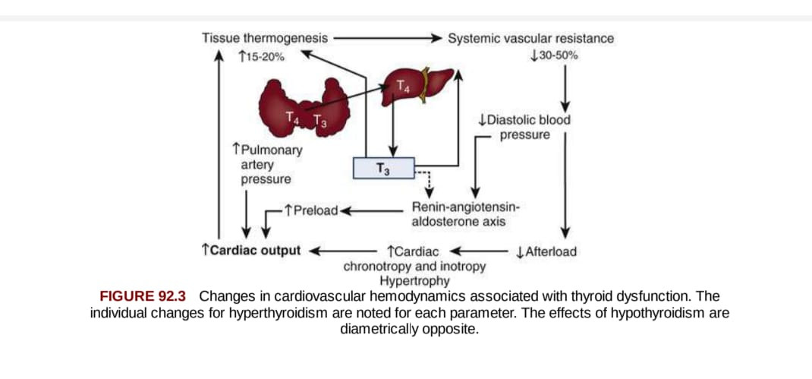

Slide 56
80% to 90% of the extrathyroidal T3 is produced by deiodination of T4 by the type I (D1) & type II (D2) deiodinases.
D1 is expressed in the liver & kidney, and D2 is expressed in the central nervous system, bone, skin, pituitary gland, brown adipose tissue, skeletal muscle, & heart.
Type 3 deiodinase (D3) can inactivate both T4 & T3 & acts primarily during embryonic life; in healthy adults, its expression persists in the heart & can arise in ischemic tissue.
Free T3 enters cells via transport proteins of the monocarboxylate transporter (MCT8, MCT10) & organic anion-transporting polypeptide 1C1 (OATP) family of cell surface transporters.

Slide 57
The thyroid hormone receptors bind as homodimers or heterodimers to the thyroid hormone response elements in a promoter region of specific genes.
Binding to the promoter regions can activate or repress gene expression.

Slide 58
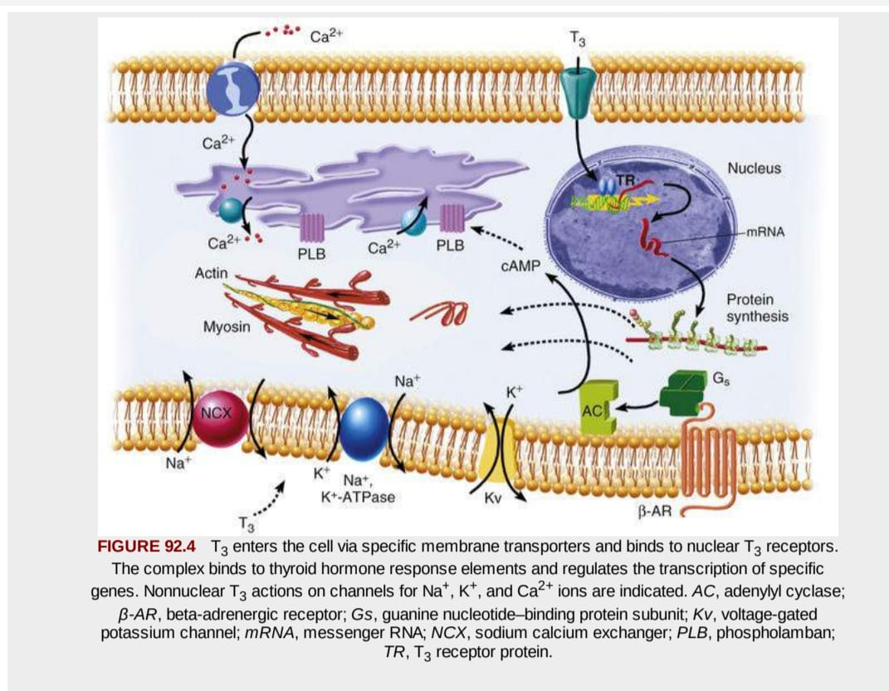

Slide 59
Thyroid hormone transcriptionally regulates many cardiac proteins , including structural & regulatory proteins, cardiac membrane ion channels, & cell surface receptors.
Major T3 targets include myosin heavy chain isoforms (alpha & beta).
The human ventricle expresses primarily beta-myosin.
Changes in myosin heavy chain isoform expression occur in the human atria in various diseases, including congestive heart failure & severe hypothyroidism.

Slide 60
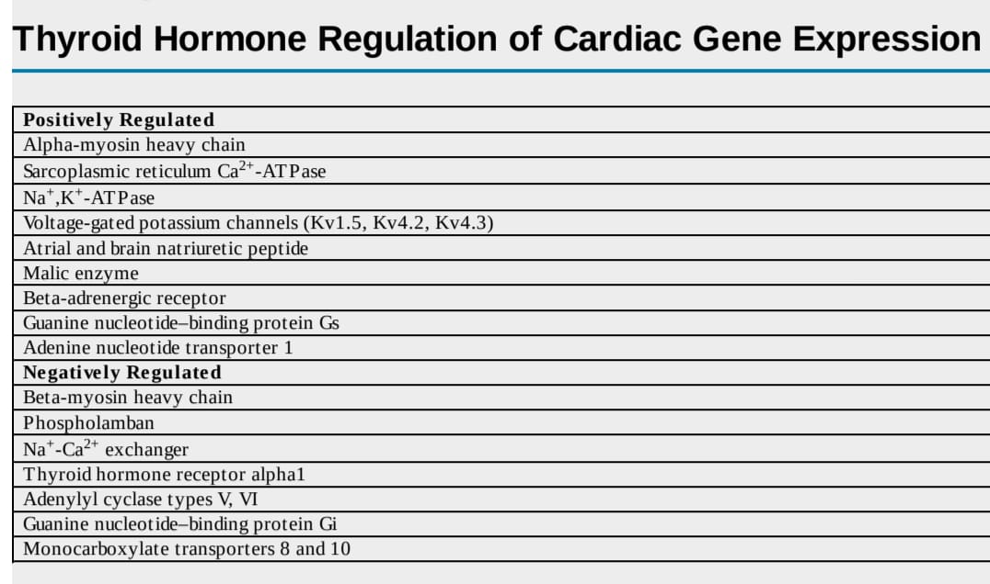

Slide 61
Sarcoplasmic reticulum Ca2+-adenosine triphosphatase (ATPase) (SERCA) is an important ion pump that determines the magnitude of myocyte calcium cycling.
Reuptake of calcium into the sarcoendoplasmic reticulum early in diastole in part determines the rate at which the left ventricle relaxes (isovolumic relaxation time).
The polymeric protein phospholamban(PLB) regulates the activity of SERCA2, and Thyroid hormone inhibits the expression of phospholamban & increases phospholamban phosphorylation.
When PLB is associated with SERCA – Ca ++ movement is reduced; disassociation occurs following phosphorylation

Slide 62
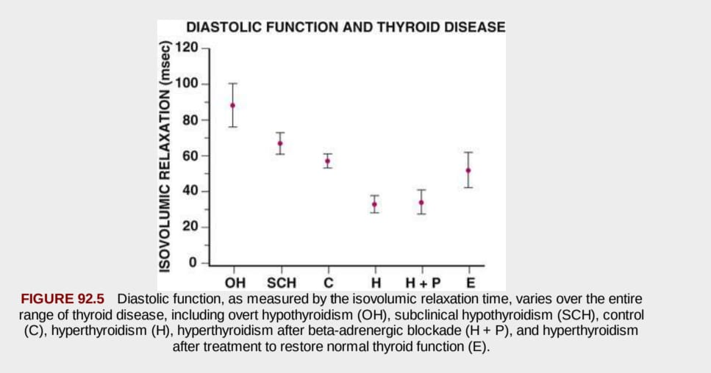

Slide 63
Diagnosis of Thyroid Function Disorders
Serum TSH levels uniformly increase in patients with primary hypothyroidism (> 4.5 mU/L), & they are low (< 0.1 mU/L) in hyperthyroidism.
In the presence of abnormal TSH levels, measurement of free thyroxine (FT4) & total T3 (TT3) or free T3 (FT3) can distinguish subclinical from overt thyroid dysfunction.
Overt & subclinical hyperthyroidism result most commonly from increased thyroid hormone synthesis related to Graves' disease, toxic adenoma, or toxic multinodular goiter.
Hashimoto disease, prior thyroid surgery, &, in some parts of the world, iodine deficiency are the most common causes of hypothyroidism.

Slide 64
Hemodynamic Alterations in Thyroid Disease
Changes in myocardial contractility & hemodynamics occur across the entire spectrum of thyroid disease.
T3 regulates cardiac inotropy & chronotropy through direct & indirect mechanisms.
T3 acts on tissues throughout the body to increase myocardial oxygen consumption & tissue thermogenesis.
T3 decreases the systemic vascular resistance in arterioles of the peripheral circulation through direct effects on vascular smooth muscle cells.

Slide 65
Moreover, thyrotoxicosis may augment the vascular endothelial generation of nitric oxide.
The drop in systemic vascular resistance results in a smaller left ventricular end-systolic volume.
A decrease in mean arterial pressure & activation of the renin-angiotensin-aldosterone system with increased serum angiotensin-converting enzyme activity occurs, as does an increase in renal sodium reabsorption.
The increase in plasma volume, coupled with an increase in erythropoietin, increases the blood volume.

Slide 66
The combination of expanded blood volume & improvement in diastolic relaxation of the heart contributes to an increased left ventricular end diastolic volume.
The systolic arterial pressure almost invariably increases & diastolic arterial pressure decreases in patients with overt hyperthyroidism, so that the pulse pressure characteristically widens & the mean arterial pressure only marginally decreases.
The net effect of an increased preload & a decreased afterload yields an increased left ventricular stroke volume in hyperthyroidism.
In turn, the rise in heart rate & the increased stroke volume combine to cause a twofold to threefold increase in cardiac output.

Slide 67
Left ventricular function falls reversibly in hypothyroidism.
The cardiac preload decreases because of the impaired diastolic function & the decreased blood volume; the left ventricular ejection fraction at rest, during exercise, & during cardiopulmonary exercise testing declines & tends to improve with restoration of euthyroidism.
The afterload increases in patients with hypothyroidism as a result of increased systemic vascular resistance, arterial stiffness, & endothelial dysfunction.
Systemic vascular resistance may increase as much as 30%, & the mean arterial pressure may rise in up to 20% of patients with diastolic hypertension.

Slide 68
The hypothyroid myocardium is energy-inefficient despite the low level of overall oxygen consumption.

Slide 69
Hyperthyroidism
Most patients experience palpitations resulting from increases in the rate & force of cardiac contractility.
Heart rates higher than 90 beats/min at rest & during sleep occur commonly.
In older hyperthyroid patients with known or suspected coronary artery disease, the increase in cardiac work associated with the increase in cardiac output & cardiac contractility can produce myocardial ischemia, which can respond to beta-adrenergic–blocking agents (beta blockers) or restoration of a euthyroid state.
Hyperthyroidism is associated with a substantial degree of pulmonary hypertension (mean pulmonary artery systolic pressure > 50 mm Hg).

Slide 70
Atrial Fibrillation in Overt Hyperthyroidism
The most common rhythm disturbance in patients with hyperthyroidism is sinus tachycardia, but atrial fibrillation causes the most clinical concern.
The prevalence of atrial fibrillation in patients with hyperthyroidism ranges from 2% to 20%.
According to the American College of Cardiology/American Heart Association, the first-line treatment of atrial fibrillation & heart failure in patients with thyroid dysfunction should aim primarily to restore a euthyroid state because cardiovascular drugs generally have a reduced efficacy in the face of thyroid hormone excess.

Slide 71
Treatment of hyperthyroidism with beta-adrenergic blockade followed by antithyroid drugs or radioiodine should be the first-line therapy.

Slide 72
Successful treatment of hyperthyroidism & restoration of normal serum levels of T4 & T3 results in reversion to sinus rhythm in two thirds of patients within 2 to 3 months.
Digitalis may help to control the ventricular response in hyperthyroidism-associated atrial fibrillation, but because of the increased rate of digitalis clearance, the decreased sensitivity of drug action, & the decreased parasympathetic tone, patients usually require higher doses.

Slide 73
Anticoagulation, in patients with hyperthyroidism & atrial fibrillation is controversial.
In younger patients with hyperthyroidism & atrial fibrillation in the absence of other heart diseases, hypertension, or other independent risk factors for embolization (CHADS VASC score = 0), the benefits of anticoagulation have not been proved & might be outweighed by the risk.
In hyperthyroid patients who do not regain normal rhythm spontaneously within 4 months of normalization of thyroid function, pharmacologic or electrical cardioversion should be considered after evaluation of the age of the patient & the underlying cardiac status.
Many such patients will warrant anticoagulant therapy.

Slide 74
Treatment of Overt Hyperthyroidism
Treatment include-
Beta-adrenergic antagonist to lower the heart rate
- Beta blockers improve the tachycardia-mediated component of ventricular dysfunction, but the direct inotropic effects of thyroid hormone will persist.

Slide 75
Thyroid storm,
the most severe form of hyperthyroidism, can present with an altered mental status; fever; gastrointestinal symptoms, including pain, nausea, & rarely jaundice; & cardiovascular findings of exaggerated tachycardia, new-onset supraventricular arrhythmias such as atrial fibrillation, or hypotension & cardiovascular collapse.
These patients require intensive care unit monitoring in addition to the use of antithyroid drugs, potassium iodide, attention to other coexistent medical problems such as infection or trauma.

Slide 76
Hypothyroidism
The cardiovascular findings of hypothyroidism are more subtle.
Mild degrees of bradycardia, diastolic hypertension, a narrow pulse pressure & relatively quiet precordium, & decreased intensity of the apical impulse are all characteristic.
Hypothyroidism also increases total & low-density lipoprotein (LDL) cholesterol in proportion to the rise in serum TSH levels.
The primary mechanism involves changes in LDL metabolism caused by decreases in the hepatic LDL receptor number & reduced activity of cholesterol 7α-hydroxylase, an enzyme that lowers cholesterol levels.

Slide 77
The serum creatine kinase (CK) level rises from 50% to 10-fold in up to 30% of patients with hypothyroidism.
Pericardial effusions can occur, & occasionally, they are large & cause the appearance of cardiomegaly on chest radiographs.
Echocardiography demonstrates small to moderate effusions in up to 30% of overtly hypothyroid patients.
As a result of changes in ion channel expression & parasympathetic tone the ECG in hypothyroidism may show sinus bradycardia, low voltage, & prolongation of the action potential duration & QT interval.

Slide 78
The QT prolongation predisposes patients to ventricular arrhythmias, & in some patients with acquired torsades de pointes, the disorder has improved or completely resolved with thyroid hormone replacement.
Increases in risk factors for atherosclerosis, including hypercholesterolemia, hypertension, endothelial dysfunction, & elevated levels of homocysteine, may elevate the risk for atherosclerosis & coronary & systemic vascular disease in patients with hypothyroidism.

Slide 79
Treatment of Overt Hypothyroidism
Replacement doses of purified preparations of levo-thyroxine sodium (L-T4) are the treatment of choice in hypothyroid patients.
Patients younger than 50 years with no history of heart disease generally tolerate full replacement doses of levo-thyroxine (1.5 μg/kg/day) without concern for untoward cardiac effects.

Slide 80
Patients older than 50 years with known or suspected coronary artery disease have more complicated issues.
Three major issues arise.
The first is whether to perform coronary artery revascularization before initiating thyroid hormone replacement.
If patients are not candidates for percutaneous intervention & have unstable angina, left main coronary artery disease, or three-vessel disease with impaired left ventricular function, even in the setting of overt hypothyroidism, coronary artery bypass grafting can be performed.

Slide 81
The second issue- patients with known stable cardiac disease in whom cardiac revascularization is not clinically indicated.
Treatment of such patients should begin with low doses (12.5μg) of levo-thyroxine & then stepwise increases (12.5 to 25 μg) every 6 to 8 weeks until the serum TSH level normalizes.
The third - involves patients who although potentially at risk for coronary artery disease, exhibit no clinical signs or symptoms.
In this group, thyroid hormone replacement can start at low doses, generally in the range of 25 to 50 μg/day, & then increase by 25 μg every 6 to 8 weeks until the serum TSH level is normal.

Slide 82
In the rare condition of myxedema coma characterized by the development of hypothermia, altered mental status, hypotension, bradycardia, & hypoventilation in patients with severe & long-standing hypothyroidism, the need for thyroid hormone replacement is more of an emergency.
Treatment can be accomplished by intravenous administration of 200 μg of L-T4 followed by 100 μg of L-T4 per day to restore vital functions in patients with severe coma.
L-T3 may also be started simultaneously with L-T4 in a dosage of 10 to 20 μg, followed by 10 μg every 6 hours for 1 or 2 days until the patient's cerebral function improves.

Slide 83
Patients with myxedema coma require intensive care unit monitoring with volume repletion, gentle warming, & ventilatory support in the presence of CO2 retention.
Administration of hydrocortisone (50 to 100 mg three times daily) should be undertaken until the results of serum cortisol testing are obtained.

Slide 84
Subclinical Hyperthyroidism
Subclinical hyperthyroidism is diagnosed when the serum TSH level is persistently subnormal or undetectable (TSH < 0.1 mU/L) & free thyroid hormone levels are in the mid-to-high range of their reference intervals.
Sinus tachycardia & atrial premature beats frequently occur in young patients, & in older patients (> 60 years), subclinical hyperthyroidism is not associated with symptoms of adrenergic overactivity; there may be associated weight loss, muscle weakness, & most importantly atrial fibrillation.
Data from all the available metaanalyses demonstrate that subclinical hyperthyroidism is associated with an increased risk of total mortality, coronary heart mortality, incident atrial fibrillation, & heart failure.

Slide 85
Subclinical Hypothyroidism
Subclinical hypothyroidism is diagnosed when the serum TSH is above the upper limit of the normal reference range & free thyroid hormones are within their respective reference range.
Patients may have mild disease (TSH 4.5 to 9.9 mU/L) or more severe dysfunction (TSH ≥ 10 mU/L).
A recent study from the United Kingdom's General Practitioners database showed that treatment of TSH levels between 5 & 10 mIU/mL lowered the incidence of ischemic heart disease events & cardiovascular mortality in patients younger than 70 years.

Slide 86
Amiodarone and Thyroid Function
Amiodarone is an iodine-rich antiarrhythmic agent used for the treatment of ventricular & atrial tachyarrhythmias.
Its 30% iodine content by weight & its structural similarity to levo-thyroxine cause abnormalities in thyroid function test results in as many as 60% of patients treated for short or long periods.
Amiodarone inhibits the 5′-monodeiodination of T4 in the liver & pituitary.
Inhibition of T4 metabolism in the liver decreases serum T3 levels & increases serum T4 levels, whereas serum TSH levels initially remain normal.

Slide 87
With more chronic treatment & as the total iodide content in the body rises, T4 synthesis & release from the thyroid gland can be inhibited, thereby producing a rise in TSH levels.
The overall prevalence of hypothyroidism in amiodarone-treated patients is between 15% & 30%.
Thyroid function should be measured every 3 months in all patients receiving amiodarone.
The effect on thyroid function does not depend on the dose & can occur at any time after initiating treatment; furthermore, because of the high lipid solubility & long half-life of amiodarone, this effect can persist up to 1 year after discontinuing therapy.

Slide 88
Less common but perhaps more challenging is the development of amiodarone-induced thyrotoxicosis.
The onset was often sudden & could occur shortly after initiation of amiodarone therapy, during chronic treatment, or up to 1 year after stopping therapy.
Clinical clues to the development of this condition include a new onset or recurrence of ventricular irritability (increased firing of an implantable cardioverter-defibrillator), decreased warfarin dose requirements, or return or worsening of the obstructive physiology of hypertrophic cardiomyopathy.

Slide 89
There are two forms of amiodarone induced thyrotoxicosis.
Type I occurs primarily in patients with preexisting thyroid disease & most commonly in iodine-deficient areas.
These patients may rarely have an increase in 24-hour radioiodine uptake & frequently some measures of thyroid autoimmunity, including antithyroid antibodies.
Type II thyroiditis – mediated by proinflammatory cytokines, including IL-6
It is primarily a destructive process causing release of preformed thyroid hormone, which may continue for weeks or months & most often is associated with low-to-absent radioiodine uptake.

Slide 90
Corticosteroids (prednisone 20 to 40 mg/day) provide benefit, perhaps with increased usefulness in patients with type II disease who have high serum levels of IL-6.
In patients unresponsive to glucocorticoids with evidence of hyperthyroidism, treatment with antithyroid therapy (methimazole 10 to 30 mg/day) is variably effective & can cause considerable side effects.
Total thyroidectomy can be performed safely & can rapidly reverse the hyperthyroidism.

Slide 91
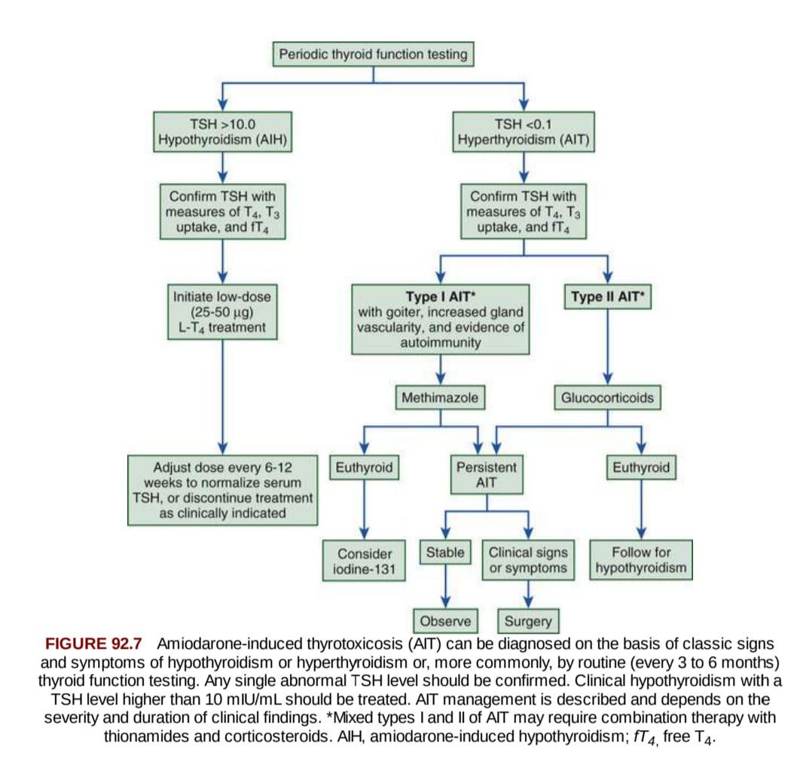

Slide 92
In addition to the changes in thyroid function that can result from classic thyroid disease, primary alterations in levels of serum total & free T3 & occasionally in serum T4 can accompany a variety of acute & chronic illnesses, including sepsis, starvation, & cardiac disease.( SICK EUTHYROID)
The mechanism for decrease in serum T3 levels is multifactorial & in part related to a decrease in 5′-monodeiodination in the liver.

Slide 93
THANK YOU

